Slide 1

BLINKIT SALES & PERFORMANCE ANALYSIS
Data-Driven Insights for Strategic Optimization
Presented by: Pampati Yashwanth | Data Analyst
Date: September 2025

Slide 2
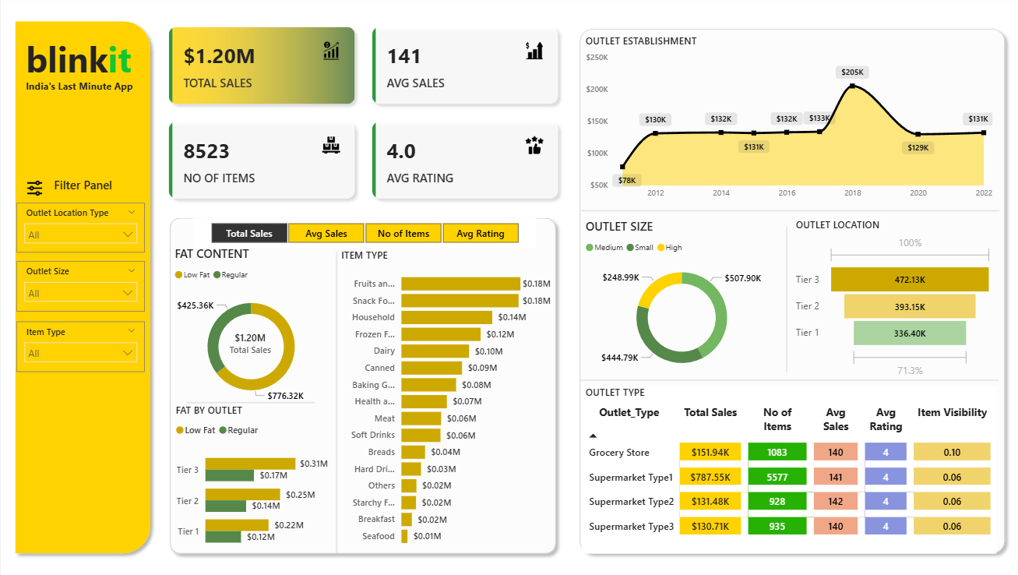

Slide 3

Business Objective
PROJECT OBJECTIVE
Analyze Blinkit's sales, customer ratings, and inventory distribution
Identify performance trends across item types, outlet types, and locations
Deliver actionable insights for business optimization
“Our goal is to uncover patterns and opportunities using key metrics like total sales, average rating, and outlet characteristics.”

Slide 4

Key Performance Indicators
KPI OVERVIEW
💰 Total Sales: $1.20M
📊 Average Sales per Item: 141
📦 Number of Items Sold: 8,523
⭐ Average Rating: 4.0
“These KPIs form the foundation of our analysis. They help us evaluate both financial performance and customer satisfaction.”

Slide 5

Sales by Fat Content
IMPACT OF FAT CONTENT ON SALES
Low Fat: Highest sales ($1.20M) and rating (4.0)
Regular & High Fat: Lower sales and ratings
Health-conscious products drive performance
“Low Fat items are clearly preferred, both in terms of revenue and customer satisfaction. This trend suggests a shift toward healthier choices.”

Slide 6

Sales by Item Type
ITEM TYPE PERFORMANCE
Top Sellers: Dairy, Soft Drinks, Meat
Lower Performers: Frozen Foods, Household, Others
Dairy: Highest rating (4.2) and average sales
“Dairy and Soft Drinks are leading categories. These insights can guide inventory planning and promotional strategies.”

Slide 7

Outlet Establishment Trends
SALES BY OUTLET ESTABLISHMENT YEAR
Older outlets (1985–2010) show steady growth
Sales increase with outlet maturity
Trust and brand familiarity play a role
“Outlets established earlier tend to perform better, indicating the value of long-term customer relationships.”

Slide 8

Sales by Outlet Size
Outlet Size Distribution
Small Outlets: 40% share
Medium: 35%
Large: 25%
Small outlets contribute significantly to total sales
“Despite their size, small outlets are major contributors. This highlights the importance of supporting smaller retail partners.”

Slide 9

Sales by Location Tier
GEOGRAPHIC SALES DISTRIBUTION
Tier 1 Cities: $0.72M
Tier 2: $0.30M
Tier 3: $0.18M
Urban areas dominate sales
“Tier 1 cities are the strongest markets. There’s potential to expand in Tier 2 regions with targeted strategies.”

Slide 10

Outlet Type Performance
OUTLET TYPE METRICS
Supermarket Type1: Highest avg sales (150) and rating (4.2)
Grocery stores and other types show moderate performance
Replicate success across similar formats
“Supermarket Type1 stands out. Understanding what drives its success can help scale performance across other outlet types.”

Slide 11

Summary of Insights
KEY TAKEAWAYS
Low Fat and Dairy items drive revenue and satisfaction
Tier 1 cities and small outlets are top contributors
Older outlets and Supermarket Type1 outperform others
Health and convenience trends influence buying behavior
“These insights give us a clear direction for improving product mix, outlet strategy, and customer engagement.”

Slide 12

Strategic Recommendations
ACTIONABLE RECOMMENDATIONS
Prioritize inventory for high-performing categories
Expand presence in Tier 1 and Tier 2 cities
Support small outlets with tailored strategies
Replicate Supermarket Type1 success model
“By aligning operations with these insights, Blinkit can enhance profitability and customer satisfaction.”

